Slide 1
Principles for Deploying a Secure Cloud Architecture
F5 EMEA Webinar
Presented by:
Stephen Archer, Senior Specialist Solutions Engineer

Slide 2

Guiding Principles for SCA

Slide 3
AWS 6 R’s Assessment
Rehost
Replatform
Retain
Repurchase
Refactor
Retire
Notes:
Which to be fair is NOT an F5 term, but rather something we see all Hyperscale Cloud Providers guide customers through. The one I’m referencing here is from AWS, but the premise of this is to go application by application and decide if you will, Rehost, Replatform, Refactor, Repurchase, Retain or Retire. This is actually a really interesting process when done and what we have found is the initial enterprise movements to cloud generally went with Rehost, also known as Lift and Shift, but those stalled and had a lot of failures. That’s not to say Rehosting isn’t a good practice, it’s just to share that you need to inform that decision on an application basis, not a grand generalize practice. The other one I would point out is Retain. This is really about the fact that this particular application doesn’t make sense to move to the cloud and you will just keep it where it is, which as you can see with the fact that multi-cloud is a reality, happens more then not. The point here is, there is a pattern to assessing and the answer is actually not to be generalized, but rather application specific.
Speaking of patterns, let’s start diving into the focus topic of today’s webinar, Architecture..
1. Rehost— Otherwise known as “lift-and-shift.”
2. Replatform — I sometimes call this “lift-tinker-and-shift.”
3. Repurchase — Moving to a different product.
4. Refactoring — Re-imagining how the application is architected and developed, typically using cloud-native features.
5. Retire — Get rid of.
6. Retain — Usually this means “revisit” or do nothing (for now).

Slide 4
AWS Well-Architected
Operational
Excellence
Performance Efficiency
Cost Optimisation
Security
Reliability

Slide 5
Perform operations as code
Make frequent, small, reversible changes
Operational Excellence
Annotate documentation
Anticipate failure

Slide 6
Implement a strong identity foundation
Enable traceability
Security
Apply security at all layers
Protect data in transit and at rest

Slide 7
Automatically recover from failure
Scale horizontally to increase aggregate system availability
Reliability
Stop guessing capacity
Manage change in automation

Slide 8
Democratise advanced technologies
Go global in minutes
Performance Efficiency
Experiment more often
Mechanical sympathy

Slide 9
Adopt a consumption model
Measure overall efficiency
Cost Optimisation
Analyze and attribute expenditure
Use managed and application level services to reduce cost of ownership

Slide 10
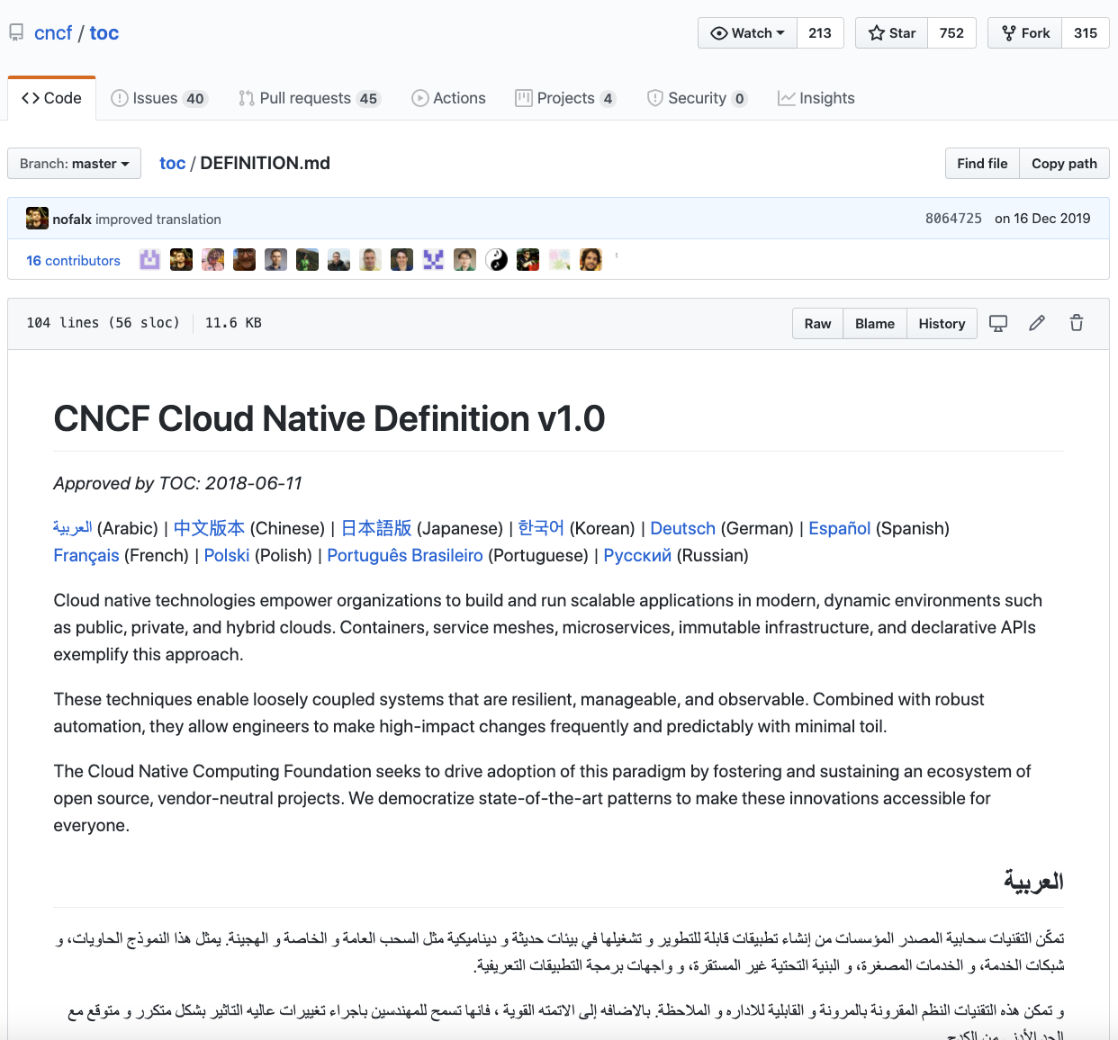
What is Cloud Native?

Slide 11
Secure Cloud Architecture

Slide 12
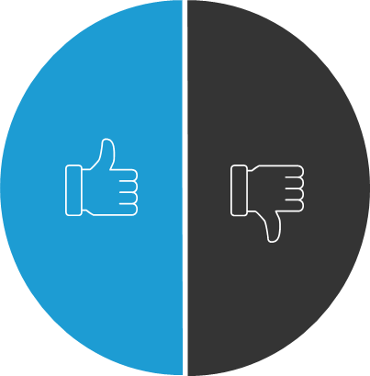
What Precisely Is a Secure Cloud Architecture?
A pattern to create an environment your team can build from
Purely focused on security or specific products in the cloud
A flexible, repeatable architecture that can be adapted for individual customers
An exact reference architecture that’s applicable to every customer
A practical approach to balancing operations and innovation at scale
A product SKU
A framework customers can adopt and use to create commonality across multi or hybrid cloud
Meant to cover every aspect in consideration
Notes:
Reference bullet points or just talk about what it is and isn’t.
Likes I have said many times and I can’t stress this enough, technology exists to deliver business outcomes, not the other way around, so let’s look at some of the outcomes you could get from designing with a secure cloud architecture.
Need to tie this back to the AWS well arcghgitected framework

Slide 13
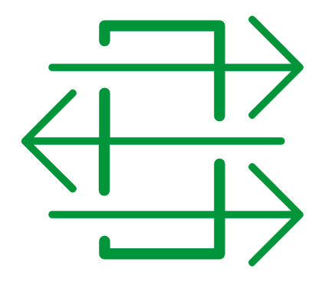



The Minimally Viable Edge
How to Customise Your Secure Cloud Architecture
Web App Firewall
Network Firewall
Global Load Balancing
Local Load Balancing
DDoS + Bot Protection
Access Management
SSL/TLS
Global Load Balancing
API Gateway
API Management
User Identity & Behaviour
Anti-fraud & Anti-abuse
Which services are common across many applications in your environment?
Notes:
So what is a minimally viable edge?
Every organization is different in terms of the number of services they need to support, security and compliance requirements, SLA’s etc. However within every application portfolio there will be a set of services that a common among applications or groups of applications. Once you identify what those services are, that’s what you place in the Minimally Viable Edge.
I would be remiss here, if I didn’t take a moment to touch on Automation and Orchestration, which we saw at the start is another technical strategy that generally is leveraged during digital transformation.

Slide 14




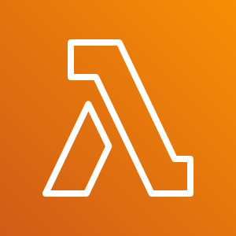






High Level Topology
AWS Cloud
Region
Development VPC
Security VPC
Availability Zone
AWS Lambda
AWS SNS
Web App Firewall
Network Firewall
Global LB
Local LB
Pilot VPC
Bot
AWS Transit Gateway
DDoS + Bot Protection
Access Mgmt.
SSL Inspection
Credential encryption
Users
API Gateway
API Mgmt.
User identity & behavior
Anti-fraud & Anti-abuse
Production VPC
Attacker
Multi-Vendor Security Inspection Tools
Notes:
Key Point:
1: Security VPC allows for a coarse filter and reusable services to be applied- I call this the Minimally Viable Edge
Most likely, these policies don’t change often, removing security baselines from the dev pipeline- IE keep security happy because they known minimums are met.
2: Reusable Services- Use example of Authentication/Authorization and could the infrastructure provide Authentication, getting closer to a Zero Trust Architecture?
3: PATTERN, PATTERN, PATTERN- You can turn all scaling for the VPC’s into a LB decision and remove the need for classic HA/API failovers and it’s the SAME across any cloud. Essentially you create a flexible baseline PATTERN. It’s all about a Pattern that can live anywhere.
F5 is Cloud Native

Slide 15

… plus Per App Services
Data Center
AWS Cloud
Region
Development VPC
Security VPC
Availability Zone
AWS Lambda
AWS SNS
Web App Firewall
Network Firewall
Global LB
Local LB
Pilot VPC
Bot
AWS Transit Gateway
DDoS + Bot Protection
Access Mgmt.
SSL Inspection
Credential encryption
Users
API Gateway
API Mgmt.
User identity & behavior
Anti-fraud & Anti-abuse
Production VPC
Attacker
Multi-Vendor Security Inspection Tools
Notes:
Key Point:
Granular control close to Dev as they now have a pattern they can count on,
2. Dev can focus on building what matters and do ADDITIONAL security to go above the baseline, ENHANCING security
3. Control/Pipeline integration-

Slide 16


… plus f5 Cloud Services
Data Center
AWS Cloud
Region
Development VPC
Security VPC
Availability Zone
AWS Lambda
AWS SNS
Web App Firewall
Network Firewall
Global LB
Local LB
Pilot VPC
Bot
AWS Transit Gateway
DDoS + Bot Protection
Access Mgmt.
SSL Inspection
Credential encryption
Users
API Gateway
API Mgmt.
User identity & behavior
Anti-fraud & Anti-abuse
Production VPC
Attacker
Multi-Vendor Security Inspection Tools
F5 Cloud Services
Notes:
Key Point:
F5 Cloud Services- Which has a goal to offer everything (long term) available in the security zone, but consumed as a Service! DNS, DNL Load Balancer are available today.
Built on AWS SaaS Factory, so it behaves more native.
Consumption based payments, available via AWS Market Place F5 offering the freedom to deploy how you choose!

Slide 17


… plus Controller Solution
Data Center
AWS Cloud
Region
Development VPC
Security VPC
Availability Zone
AWS Lambda
AWS SNS
Web App Firewall
Network Firewall
Global LB
Local LB
Pilot VPC
Bot
AWS Transit Gateway
DDoS + Bot Protection
Access Mgmt.
SSL Inspection
Credential encryption
Users
API Gateway
API Mgmt.
User identity & behavior
Anti-fraud & Anti-abuse
Production VPC
Attacker
Multi-Vendor Security Inspection Tools
F5 Cloud Services
Notes:
Key Point:
F5 Cloud Services- Which has a goal to offer everything (long term) available in the security zone, but consumed as a Service! DNS, DNL Load Balancer are available today.
Built on AWS SaaS Factory, so it behaves more native
Consumption based payments, F5 offering the freedom to deploy how you choose!

Slide 18


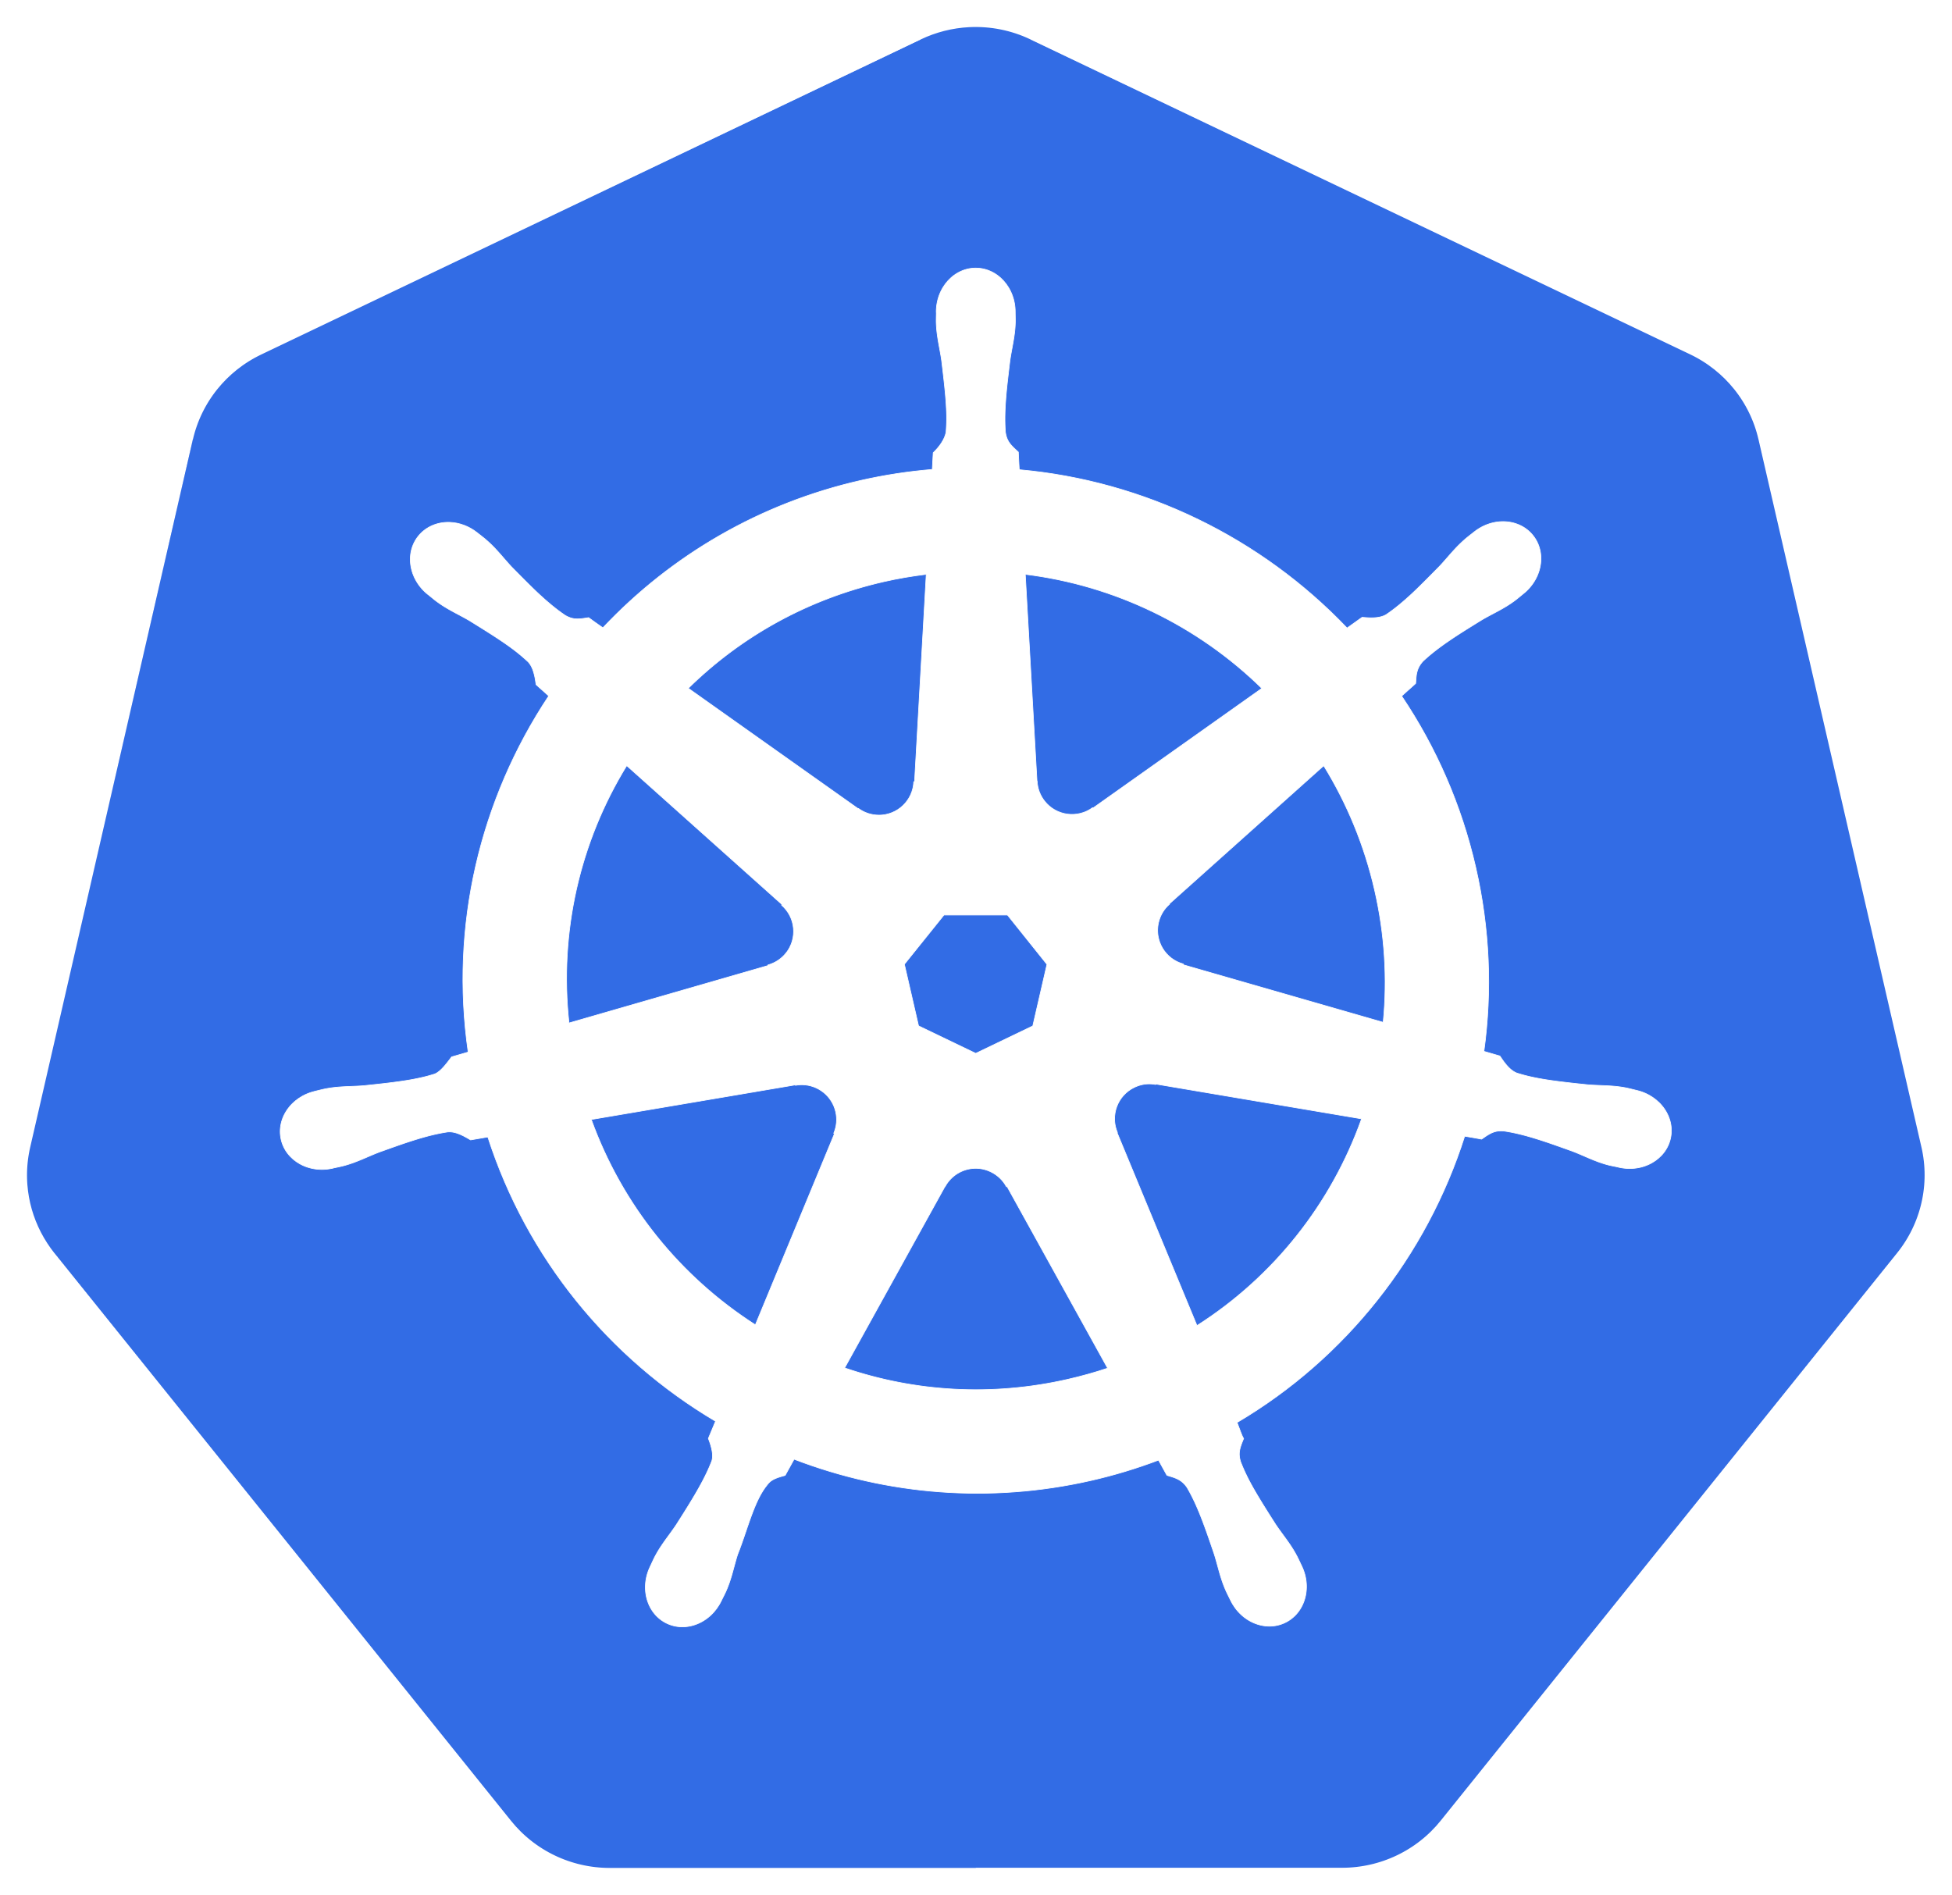
… plus Containers
Data Center
AWS Cloud
Region
Development VPC
Security VPC
Availability Zone
AWS Lambda
AWS SNS
Web App Firewall
Network Firewall
Global LB
Local LB
Pilot VPC
Bot
AWS Transit Gateway
DDoS + Bot Protection
Access Mgmt.
SSL Inspection
Credential encryption
Users
API Gateway
API Mgmt.
User identity & behavior
Anti-fraud & Anti-abuse
Production VPC
Attacker
Multi-Vendor Security Inspection Tools
F5 Cloud Services
Notes:
Key Point:
F5 Cloud Services- Which has a goal to offer everything (long term) available in the security zone, but consumed as a Service! DNS, DNL Load Balancer are available today.
Built on AWS SaaS Factory, so it behaves more native
Consumption based payments, F5 offering the freedom to deploy how you choose!
Now I do want to circle back for a moment and spotlight the Security VPC, which we call he Minimally Viable Edge…

Slide 19




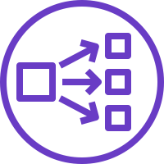
Typical Security VPC
AWS Cloud
Tier 1 DNS Load Balancing
eu-west-2a
eu-west-2b
Security VPC
Security VPC
Elastic IP
Elastic IP
AWS Network Load Balancer
AWS Network Load Balancer
L4 Firewall
L4 Firewall
AWS Network Load Balancer
AWS Network Load Balancer
L7 Web App Firewall
L7 Web App Firewall
AWS Network Load Balancer
AWS Network Load Balancer
L4 Firewall
L4 Firewall
AWS Network Load Balancer
AWS Network Load Balancer

Slide 20



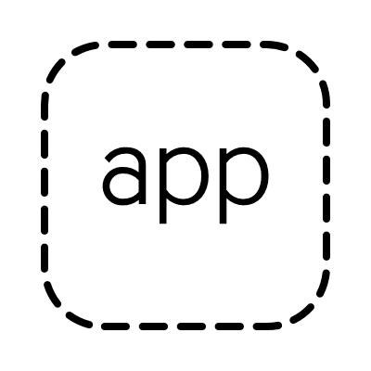
Repeatable Units for HA
AWS Cloud
Tier 1 DNS Load Balancing
eu-west-2a
eu-west-2b
eu-west-2c
eu-north-1a
eu-north-1b
eu-north-1c
Security VPC
Security VPC
Transit Gateway Peering
App VPC
App VPC
Auto-scaling group
Auto-scaling group

Slide 21
Imperative vs Declarative
IMPERATIVE
VS
DECLARATIVE
Tell the system HOW to do something – every step of the way
Tell the system WHAT you want, and let it figure out HOW to do it
Declarative API: You define the desired end-state, it fills in the details on “how to get there”
F5 is leading this fundamental shift required for Cloud and DevOps
Notes:
​When thinking about Automation though, it’s important to understand the 2 models, Imperative and Declarative. The traditional way of deploying systems uses what’s called an Imperative model in which you need to specify each step of a configuration in order to reach a desired end-state. ​
​
This means clicking around in a GUI, typing in commands in a CLI, and even using multiple API calls. ​
​
While this approach indeed works, it has its own pitfalls, namely:​
It requires system-specific domain knowledge​
It requires many steps to be completed in a specific order, making it error-prone​
It’s not amenable to the automation and orchestration paradigms required by today’s cloud and DevOps deployments​
​
The declarative model flips this over on its head and enables you to just specify the desired end-state via a JSON document, and letting the system figure out how to configure itself to that end-state, all via a single API call.​
​
This simplifies & speeds up the deployment process, makes deployments repeatable, minimizes deployment errors, and makes it easy to integrate the deployment of services into a broader orchestration system.​
Now, that we understand models or HOW, let’s look at the automation lifecycle..

Slide 22
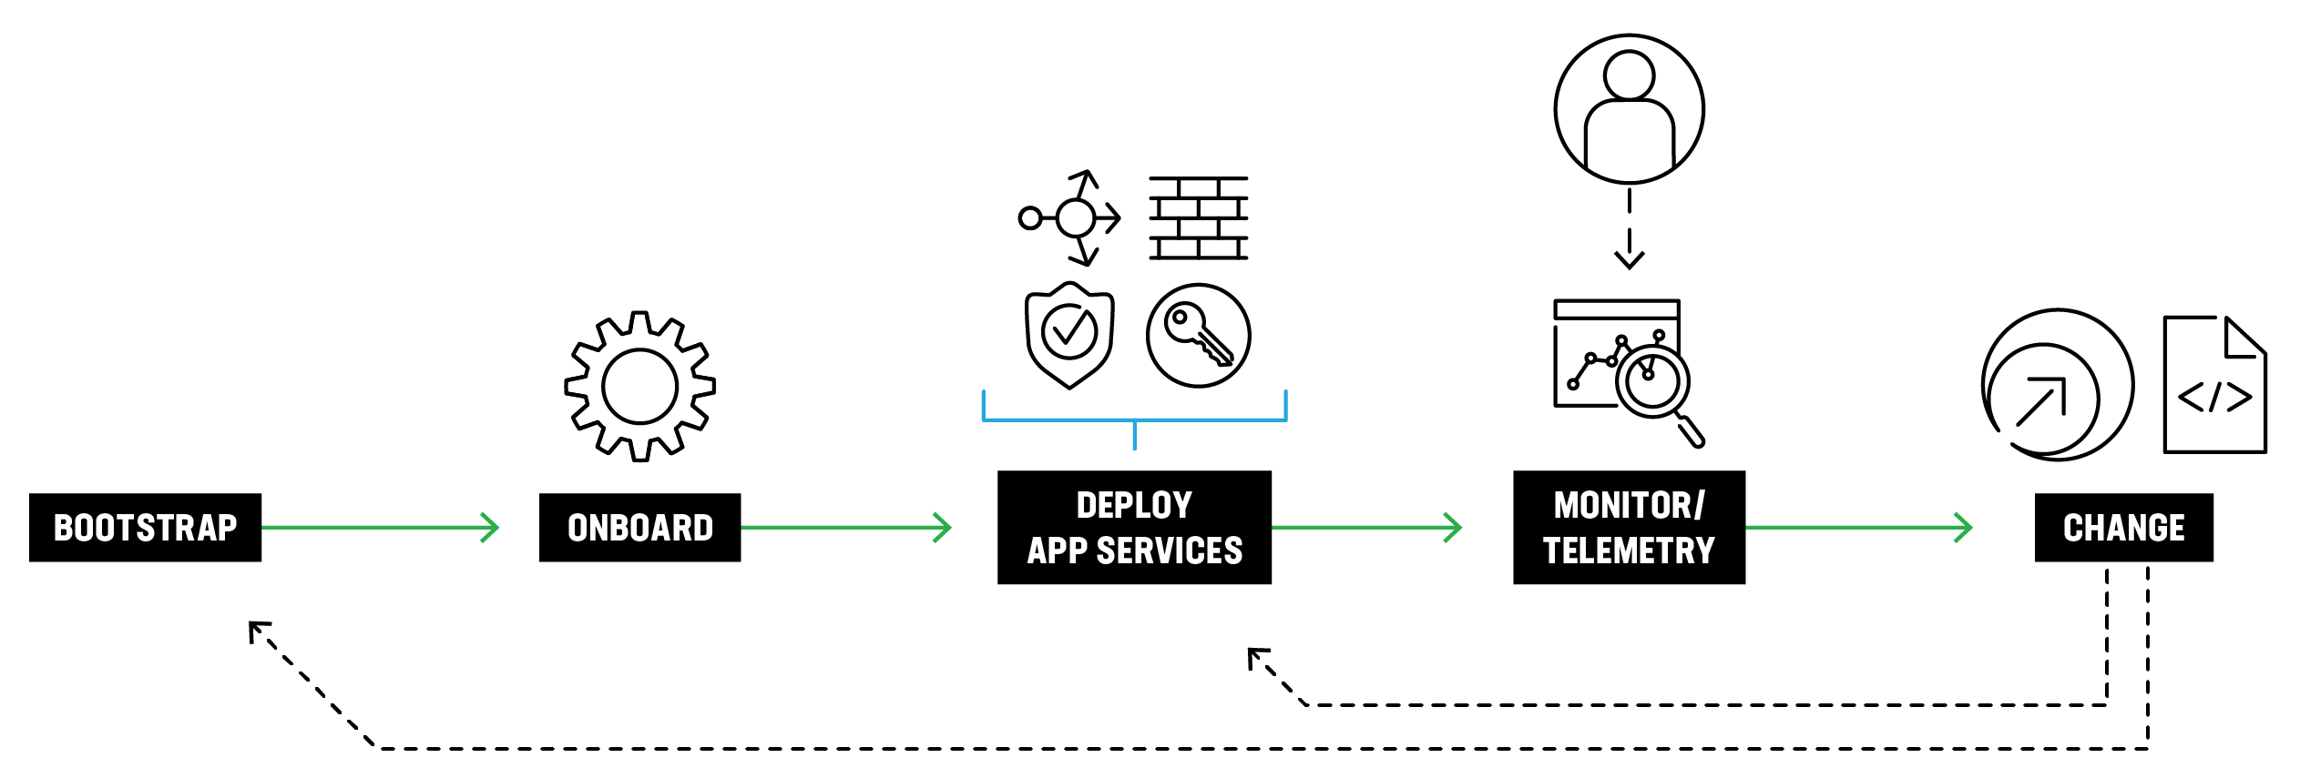
Automation Lifecycle
Notes:
Describe the cycle in simple terms:
Bootstrap- Get the basic software deployed and “stood up”
Onboard- Configure baseline functionality so the system is “online”
Deploy/config- Deploy the working config, so it can “do something valuable”
Monitor/telemetry- Receive data back to “analyze or inform”
Change- Exactly what it says☺
Now before we show you some example PATTERNS, let me first explain how F5 is approaching each step of this lifecycle in a declarative way..

Slide 23
F5 Automation Toolchain
BOOTSTRAP
ONBOARD
DEPLOY APP SERVICES
MONITORING/TELEMETRY
CLOUD TEMPLATES
DECLARATIVE ONBOARDING EXTENSION
APP SERVICES 3 EXTENSION
TELEMETRY STREAMING EXTENSION
Start BIG-IP instances in public and private clouds
Initial configuration of BIG-IP instances
Deploy classic and advanced application services on BIG-IP using declarative REST APIs
Stream telemetry, events, and logs from BIG-IP to various analytics and logging solutions
L1-L3
L4-L7
Notes:
To support the automation lifecycle, we offer the F5 Automation Toolchain – a group of free, open sourced, supported, and inter-related tools designed to allow you to automate the delivery of security and network application services. The Automation Toolchain provides a declarative “single API call” abstraction layer to simplify deployment of complex BIG-IP configurations. ​
​By reducing the API surface area down to a single declarative REST API call, the Automation Toolchain simplifies and speeds integrations into CI/CD pipelines so organizations can spend more time and resources building applications instead of integrations.​
The Automation Toolchain includes:​
F5 Cloud Templates which help you quickly and consistently deploy and configure F5 services across multiple public & private cloud environments. The templates can be integrated with 3rd party automation tools such as Chef, Puppet, and Ansible to simplify the creation and operation of autonomous cloud architectures.​
F5’s Declarative Onboarding which uses a declarative model to initially configure BIG-IP devices to make it available on the network, which again, requires only a single REST API call.​
Next is F5 Application Services 3 Extension or AS3 which automates configuration of L4-L7 application services, including local traffic management, global traffic management, security policy attachments, and more. AS3 simplifies deployment of BIG-IP’s core value by abstracting away complexity and minimizing the need for BIG-IP domain knowledge. Later in this presentation we will show how this approach makes it easy to integrate F5 services into a CI/CD pipeline using established tools including GitHub, Ansible Tower, and Jenkins.​
Finally, F5’s Telemetry Streaming Extension provides a simple declarative interface that enables organizations to aggregate, normalize, and forward statistics and events from BIG-IP to a consuming application. This application can be another link in the toolchain or a 3rd party tool such as Splunk, Kafka, Sumo Logic, Graphite, and many more.​
​In summary, the F5 Automation Toolchain provides composable components that allow you to easily integrate F5 platforms into automation pipelines using modern automation patterns. ​
Now, let’s look at how you can mature your automation to match where you are in the journey.

Slide 24
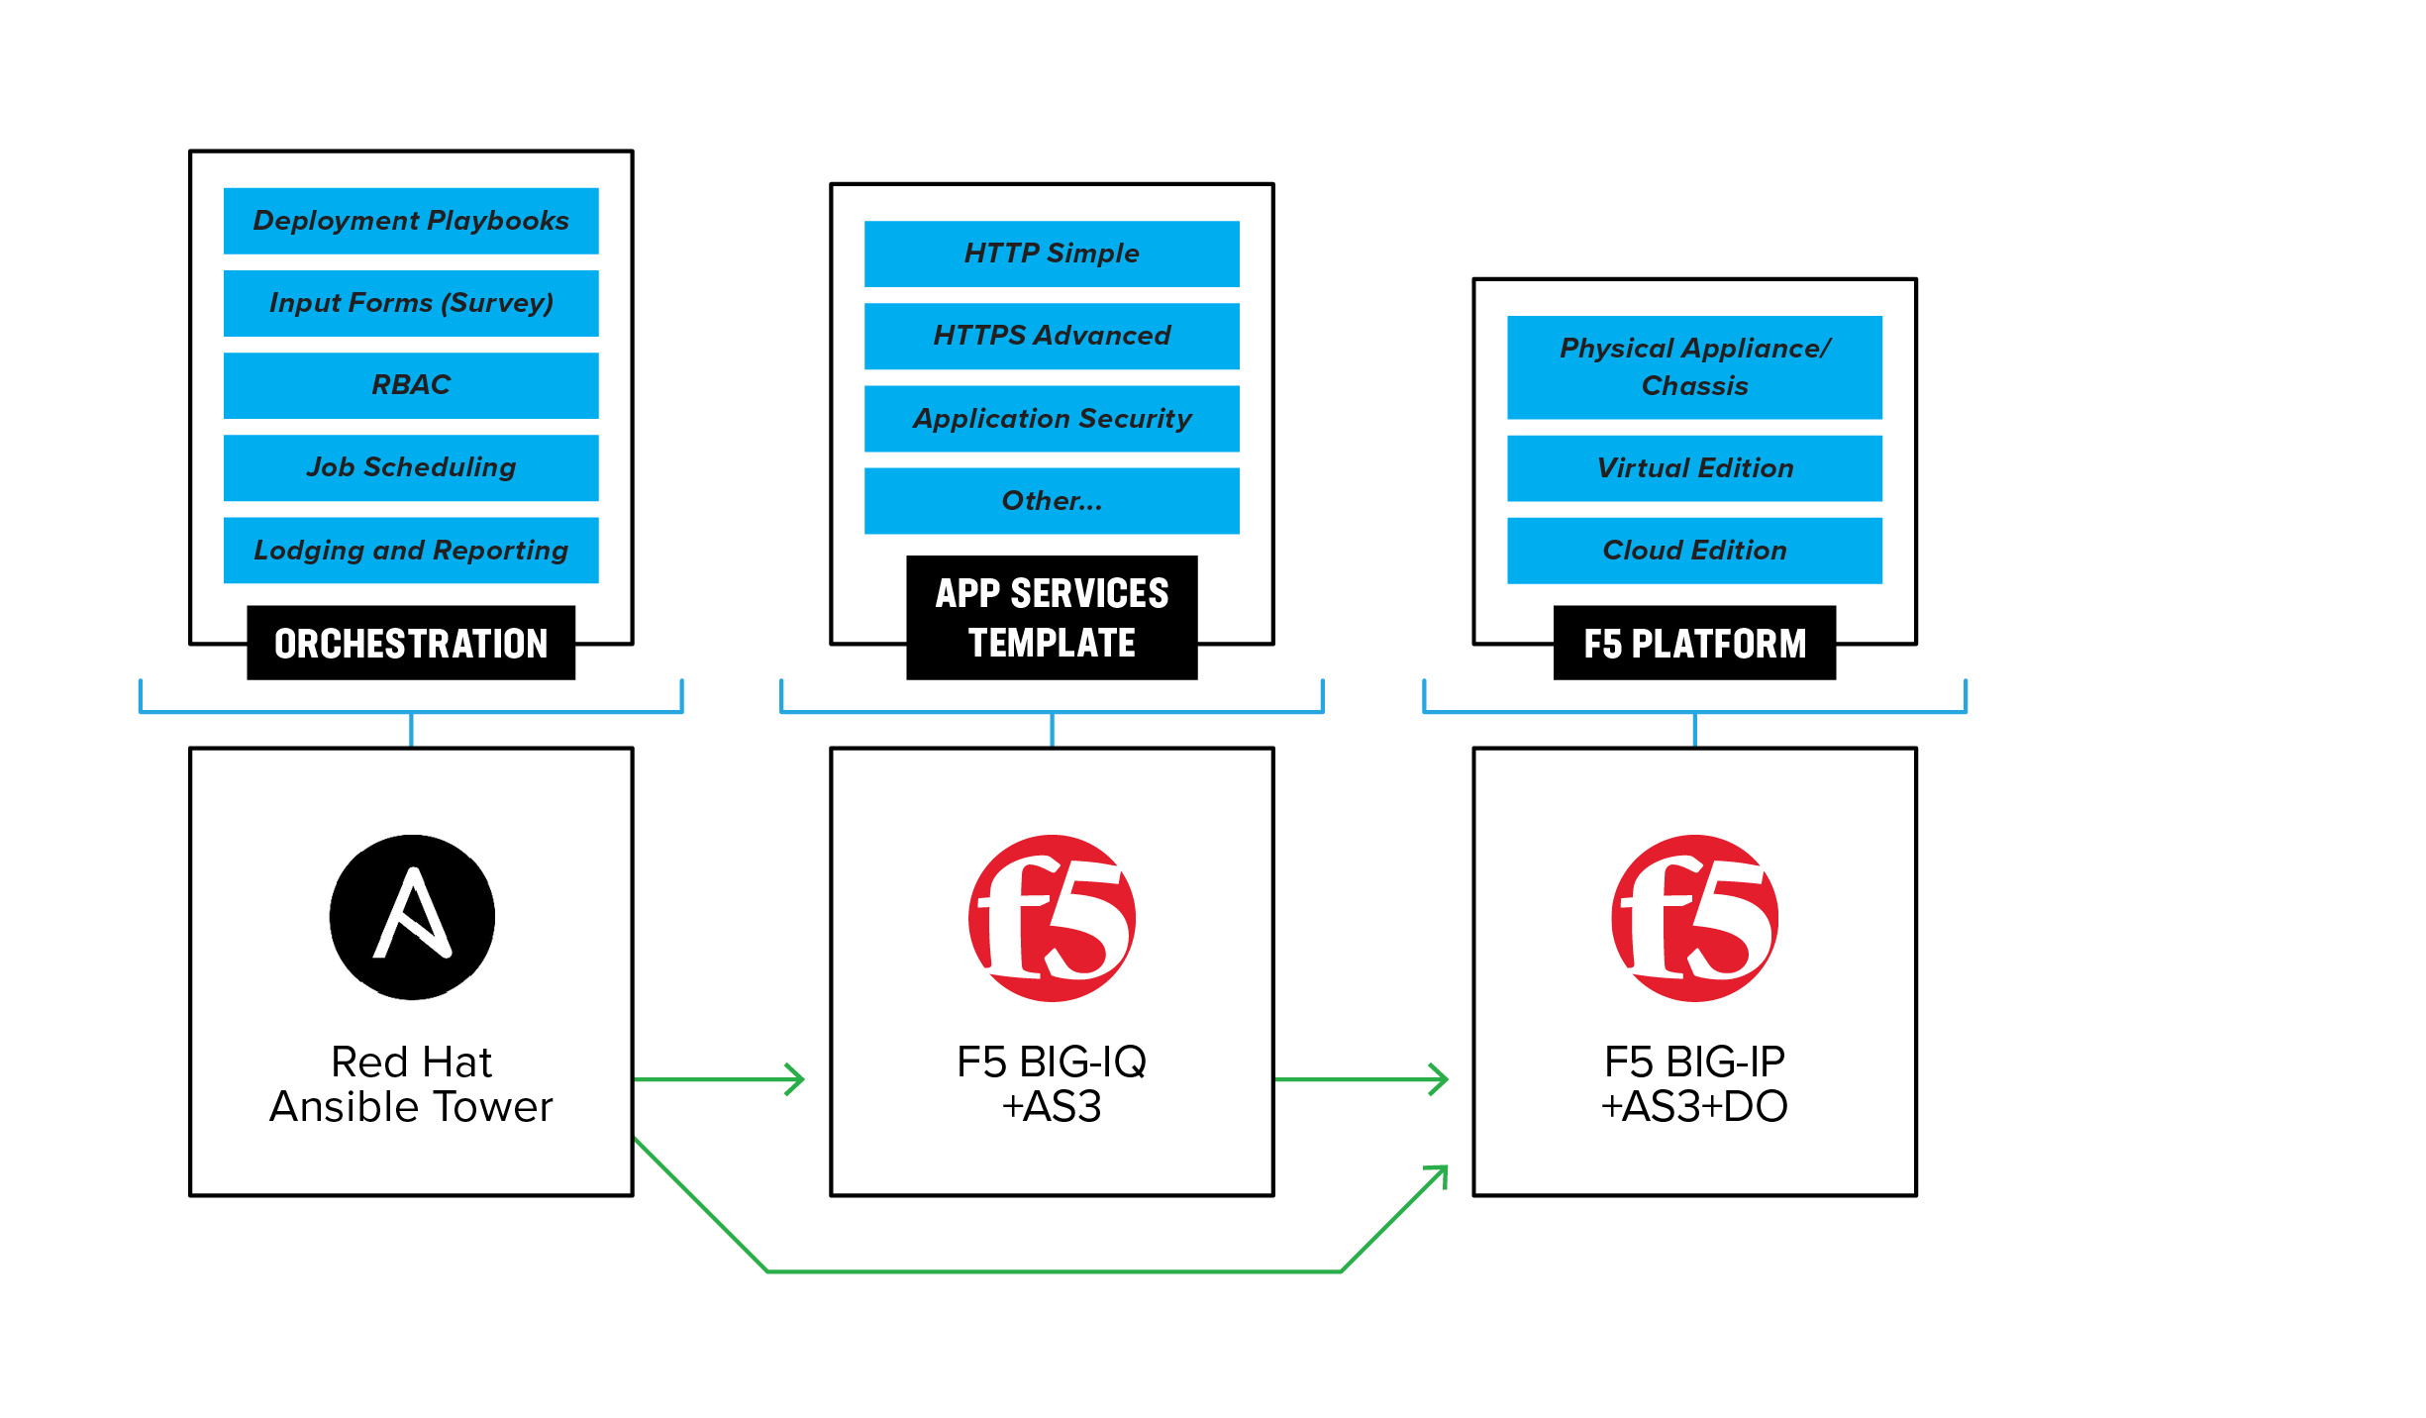
Key to Automation Success: Start Simple
INFRASTRUCTURE AS CODE DEPLOYMENT WITH TERRAFORM
Deployment Configs
Self-Service Templates
RBAC
Protected Variables
Policy as Code
Terraform
Enterprise
Notes:
Normal SE talk track

Slide 25
Key to Automation Success: Start Simple
Configuration Management Using Red Hat Ansible Tower
Notes:
Normal SE talk track

Slide 26
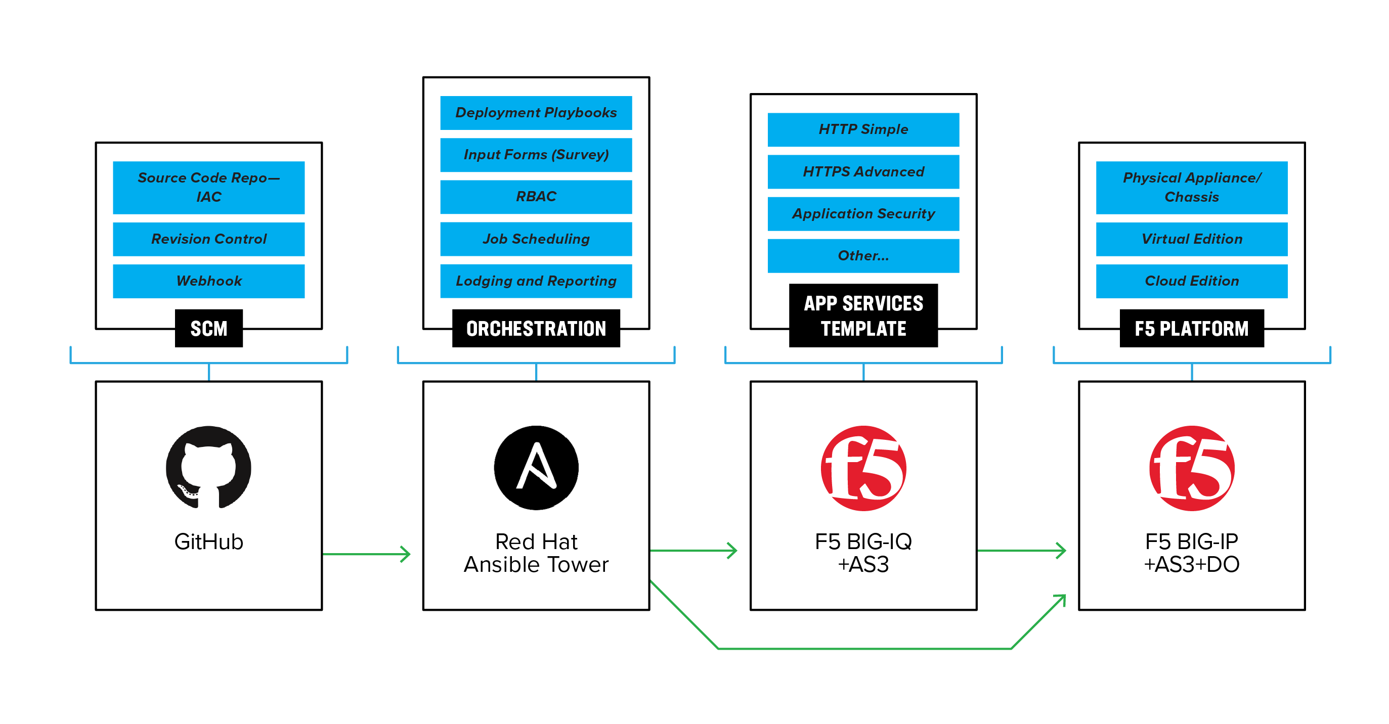
Use a Source Code Repository
Infrastructure as Code
Notes:
Normal SE talk track

Slide 27
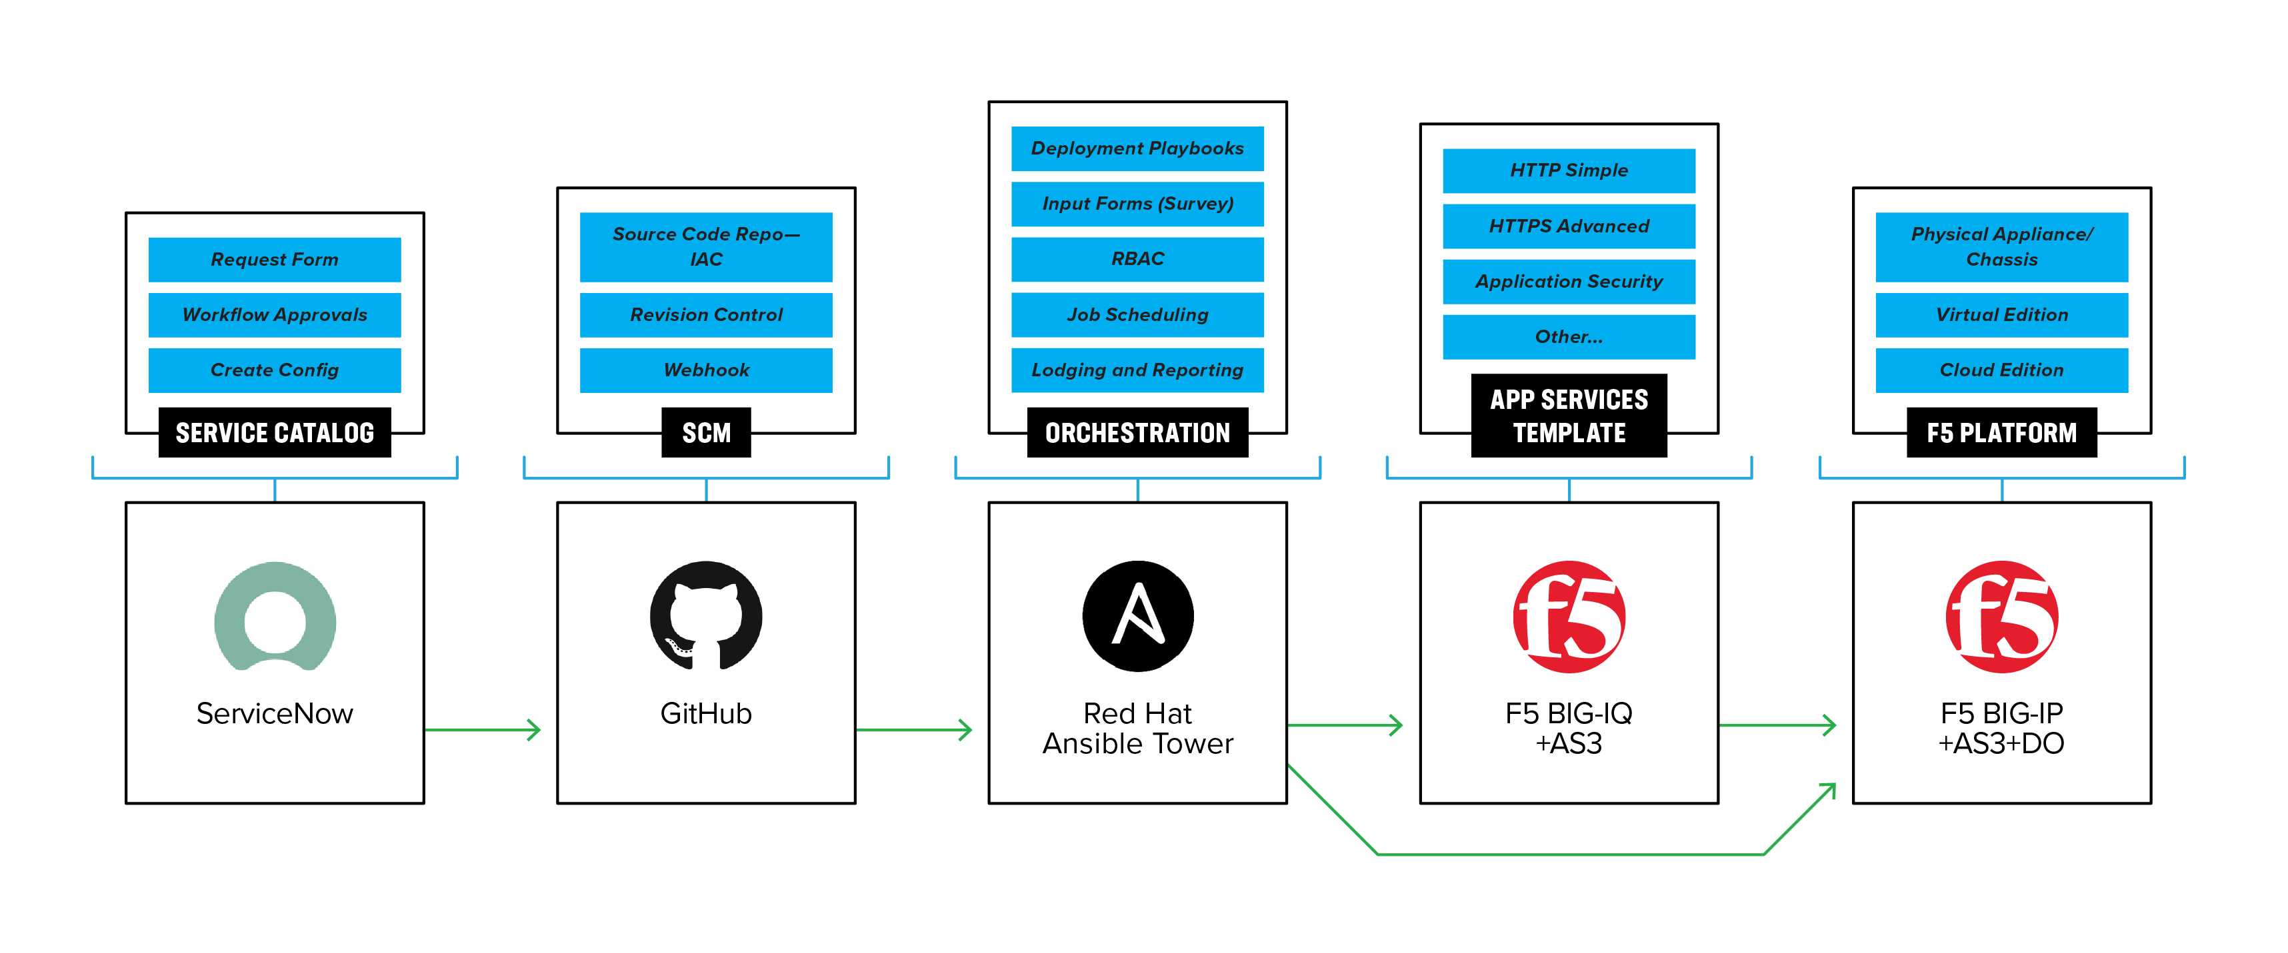
Provide Access for Non-Programmatic Consumers
Self-service provisioning via Service Catalogue
Notes:
Normal SE talk track

Slide 28
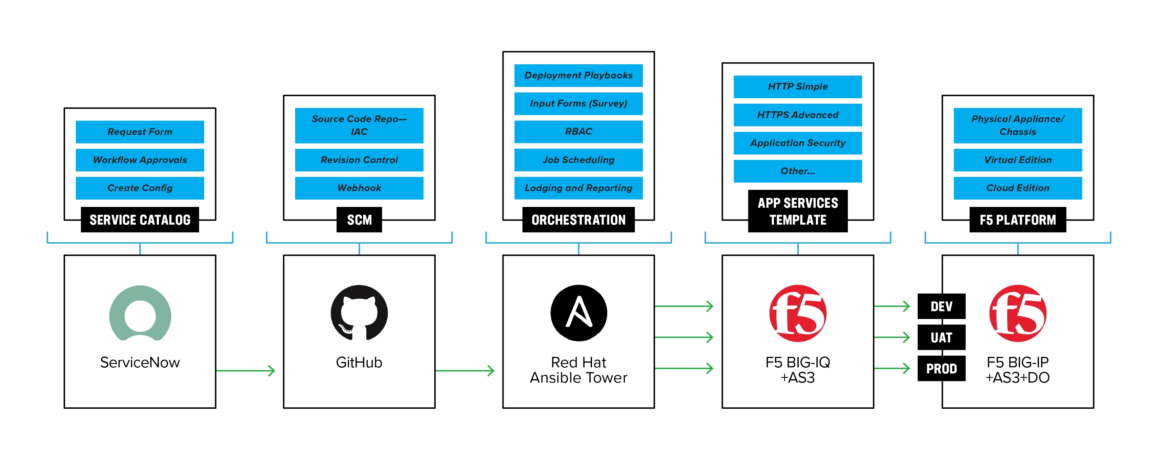
Automate Throughout the Application Lifecycle
Automated staging and testing before deployment in Production
Notes:
Normal talk track
So as you can see, Automation and Orchestration is also about defining patterns and applying tools. But if you don’t understand the outcome you are after with A/O you will find that very quickly you will have north of 20 tools all trying to accomplish the same thing, which leads me back to the analogy…

Slide 29
Putting it Together

Slide 30

What’s Next?
Work with F5 cloud experts to
Develop a specific version of the architecture that meets your needs
Tune the design to meet your desired outcomes and principles
Request a free workshop on Secure Cloud Architecture

Slide 31
Notes:
Thank you for your time
We look forward to engaging with you

